Slide 1
Project Progress Report
Team 07 Department of Artificial Intelligence Cyber Security College of Science & Technology

Slide 2

Contents
Project API
Development Progress
Organization: https://github.com/ku-aics201-23s-team07

Slide 3
Project API

Slide 4
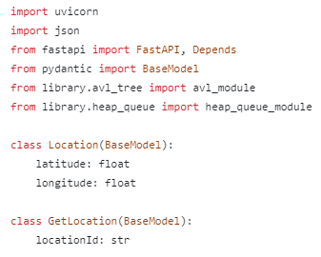
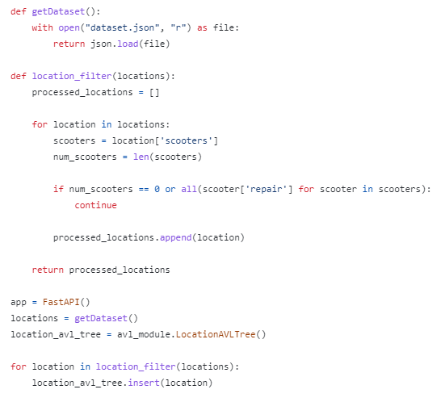
Development Progress
Class & Definition
Dataset

Slide 5
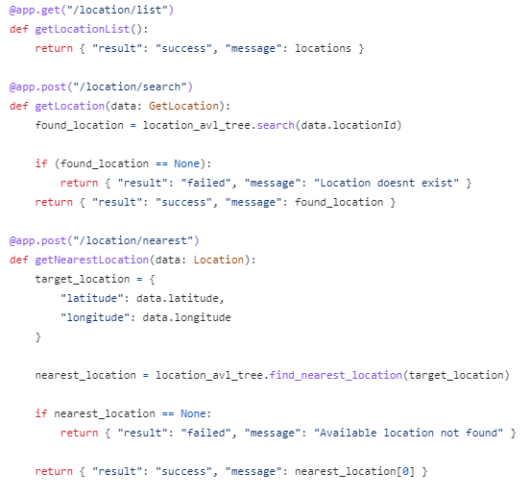
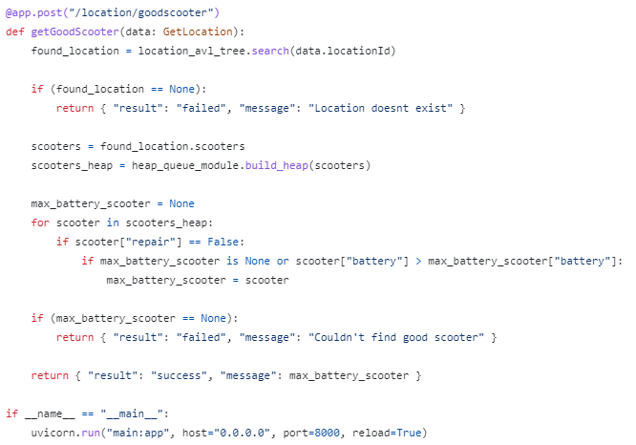
Development Progress
Location Search
Is It Good Scooter?

